Slide 1

Department of Computer Science And Engineering Jawaharlal Nehru Technological University Hyderabad University College of Engineering, Science & Technology Hyderabad Kukatpally,Hyderabad,Telangana(India) - 500085
DISSERTATION WORK REVIEW I
Federated IoT Attack Detection with Explainability
PRESENTED BY
Raipelly Srinidhi
22011P0503
CSE IDP(V-I)
GUIDE
Dr. V UMA RANI
Proffesor,CSE
JNTUH UCESTH
1

Slide 2
List of Contents
ABSTRACT
INTRODUCTION
EXISTING SYSTEM
PROBLEM STATEMENT
DATASET DETAILS
PROPOSED ARCHITECTURE
PROPOSED METHODOLOGY
REFERENCES
2

Slide 3
ABSTRACT OBJECTIVE To investigate a Federated Learning-based IoT attack detection framework with client-level explainability for effective and interpretable intrusion detection while reducing the need to centrally collect raw network traffic.
KEY FEATURES
• Uses IoT-23 and TON_IoT datasets for IoT attack detection. • Trains CNN models locally on distributed clients and uses FedAvg to build a global model without sharing raw data. • Uses SMOTE to handle class imbalance across clients. • Uses SHAP to explain predictions and compare important features across clients. • Evaluates detection performance and cross-dataset generalization against centralized baseline models.
• Evaluates the impact of heterogeneous/non-IID client data on attack detection performance.
• Measures communication overhead and model performance to compare centralized and federated approaches.
3

Slide 4
INTRODUCTION
IoT Networks:
Generate large volumes of distributed and heterogeneous traffic.
Vulnerable to attacks such as DDoS, Botnet, and Reconnaissance.
IoT Intrusion Detection:
Machine Learning can classify network traffic as normal or malicious.
Centralized detection requires collecting data at a central server.
Federated Learning:
Enables collaborative model training across clients.
Raw data remains local; only model updates are shared.
Explainability:
SHAP explains why a model predicts an attack. Helps compare important features across clients
This project combines Federated Learning and SHAP for explainable IoT attack detection..
4

Slide 5
EXISTING SYSTEM AND CHALLENGES.
Existing IoT Intrusion Detection
Uses Machine Learning/Deep Learning to classify network traffic as normal or malicious.
Traditional approaches rely on centralized data collection.
Recent approaches explore Federated Learning and Explainable AI.
Key Challenges
Privacy: Sharing raw IoT network traffic with a central server.
Communication: High data-transfer requirements in distributed environments.
Client Heterogeneity: Different clients have different traffic distributions.
Class Imbalance: Rare attack categories may be underrepresented.
Explainability: Understanding why the model predicts a particular attack.
Research Need
Investigate client heterogeneity, explainability, and cross-dataset generalization in federated IoT attack detection.
5

Slide 6
PROBLEM STATEMENT
• Centralized IoT intrusion detection requires raw traffic collection, creating privacy and communication concerns, while heterogeneous client data can affect detection performance.
• Federated models may lack interpretability, making it difficult to understand why different clients classify traffic as malicious.
6

Slide 7
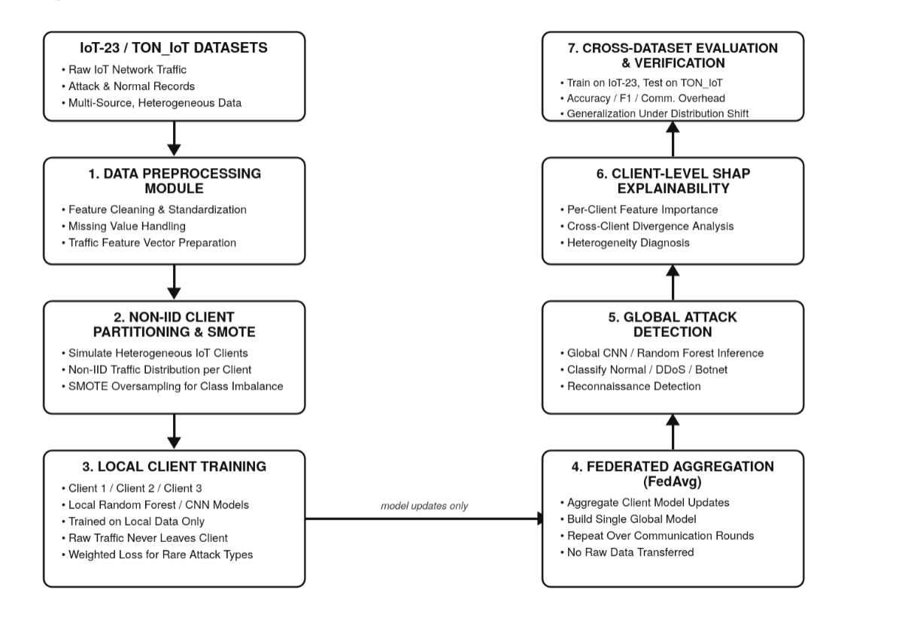
7

Slide 8
PROPOSED METHODOLOGY
• Collect and preprocess IoT network traffic from IoT-23 and prepare the data for model training.
• Partition the training data into multiple heterogeneous (Non-IID) clients to represent different IoT environments.
• Train a CNN model locally on each client's data without sharing the raw network traffic.
• Send only the local model updates from the clients to the federated server.
• Apply Federated Averaging (FedAvg) to combine the local updates and create an updated global CNN model.
• Use the global CNN model to classify network traffic as Normal or Attack.
• Apply SHAP to explain predictions and identify important network features at the client level.
• Evaluate the model's detection performance and explainability across heterogeneous clients.
8

Slide 9
REFERENCES
[1] A. Srivastava, A. Jindal, A. Shrivastava, and V. Sawan, “A Review on IoT Attack Detection Using Machine Learning Algorithms,”. “https://doi.org/10.1109/ICDICI66477.2025.11135398"
[2] B. McMahan, E. Moore, D. Ramage, S. Hampson, and B. A. y Arcas, “Communication-Efficient Learning of Deep Networks from Decentralized Data,”
[3] E. Mármol-Campos, P. Fernández-Saura, A. González-Vidal, J. L. Hernández-Ramos, J. Bernal Bernabé, G. Baldini, and A. Skarmeta, “Evaluating Federated Learning for Intrusion Detection in Internet of Things: Review and Challenges,” .
[4] S. Garcia, A. Parmisano, and M. J. Erquiaga, “IoT-23: A Labeled Dataset with Malicious and Benign IoT Network Traffic,” .
[5] S. M. Lundberg and S.-I. Lee, “A Unified Approach to Interpreting Model Predictions,”
9

Slide 10
THANK YOU
10

